Slide 1

LLM Projects Overview
Le Trung Kien
28/03/2025

Slide 2
Table of content
LLM-based Question Answering System for HUST
Visual Question Answering

Slide 3
1. LLM-based Question Answering System for HUST

Slide 4
1.1. Introduction
Motivation:
HUST admits thousands of students every year, with massive amount of information
Whenever students have questions, they would need to contact the school office, or ask on the Internet
Inconvinient due to long respond time and sometimes Internet information is incorrect
Create a chatbot interface
Goal:
Create a QA system for fast, robust answering about HUST documents/regulations + lecturers

Slide 5
1.1.1. Proposed Solution
There have been many ways to build QA systems
Inspired by advancements in Generative AI and Agentic AI, I propose a workflow that include the following modules:
Router: decide what the questions is asking about: documents/regulations or lectures/personnel or an irrelevant question.
RAG: answer questions related to documents/regulations.
Text2SQL: answer questions about personnel (currently only SoICT lecturers/personnel).
Web Search: search the web for context if no documents is found in RAG or no results in Text2SQL.
Details will be shown in latter parts.

Slide 6
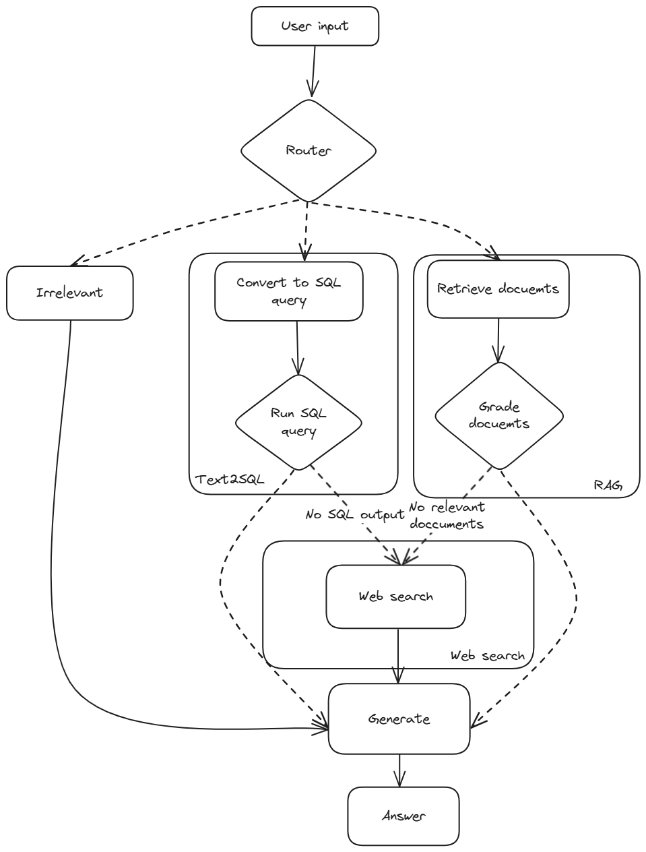
1.1.1. Proposed Solution

Slide 7
1.1.2. Reasons for solution
Make use of Large Language Models for complicated and long context QA.
Lecturer data more structured → use Text-to-SQL to make responses faster and more structrured, reducing computational overhead at the same time.
RAG to deal with PDF documents that contains text, tabular data.
Web search: since the databases might not be enough or updated -> only used when no data can be found (based on Corrective RAG).

Slide 8
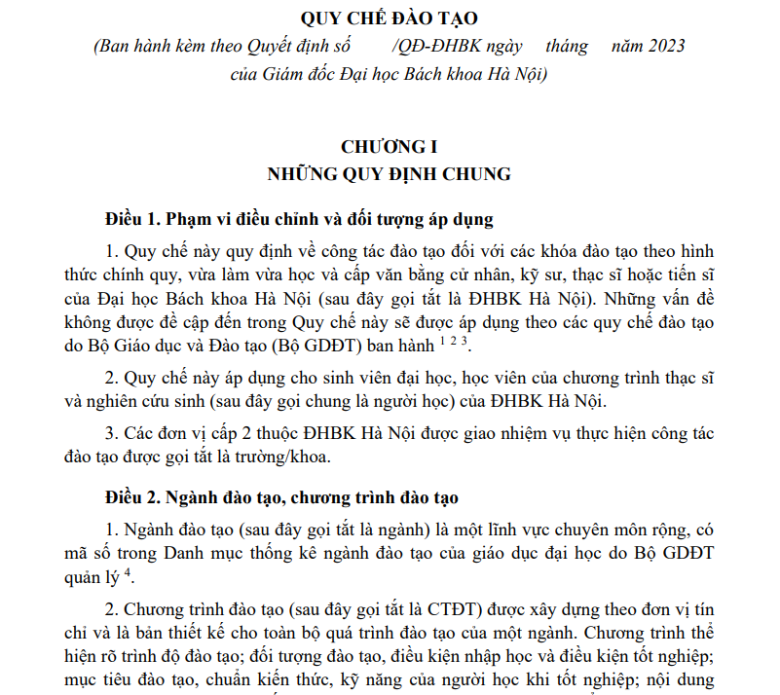
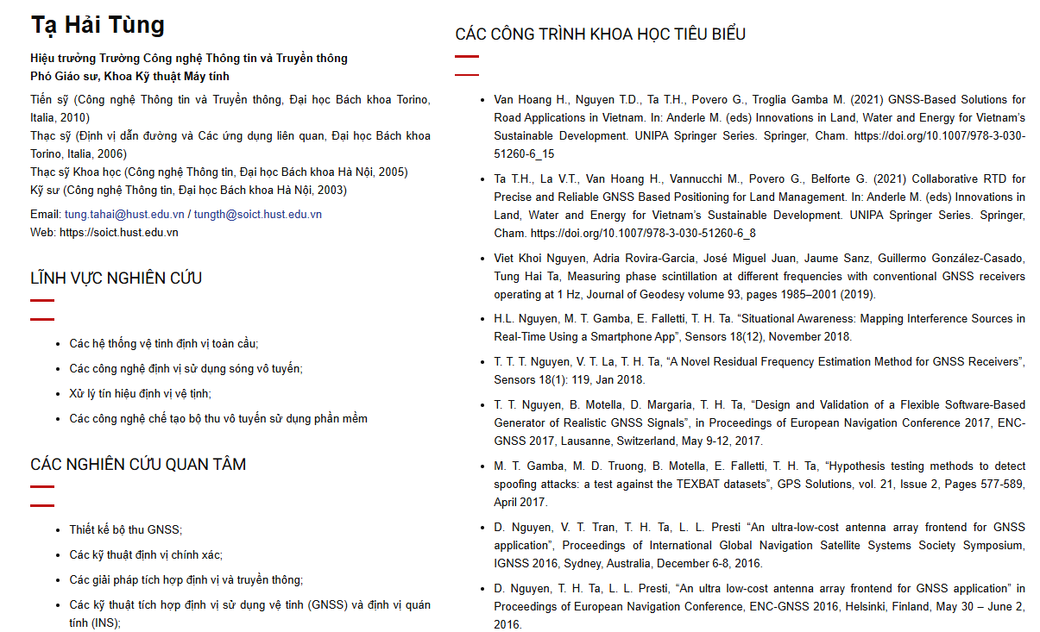
1.2. Data preparation
We have 2 fields of data needed to be answered:
Documents/regulations: including Quy chế đào tạo, Quy chế tuyển sinh,…
Lectures: name, email, teaching subjects, research fields,…
Each requires different collection + preprocessing methods

Slide 9
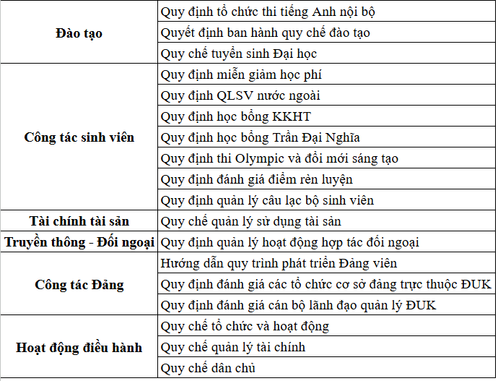
1.2.1. Documents/Regulations data
Collected 19 PDFs file on websites.
Documents can be PDF text or scanned images of documents. Only contains text and tabular data.

Slide 10
1.2.1. Documents/Regulations data
Parsed the data into raw text using LlamaParse
LlamaParse is genAI-native parsing platform
Transform complex documents (with tables, charts, images, flow diagrams etc) into clean data for LLM applications.
Supports multiple languages, with state-of-the-art parsing.
Supports many file types (pdf, ppt, html,…) and export formats (text, markdown).
Currently, text is the chosen output format.
Will compare performance with markdown later.

Slide 11
1.2.2. Lecturer data
Lecturer data crawled from SoICT website.
Used with BeautifulSoup and requests to crawl HTML content and parse information.
Saved to JSON file with following fields of information.
Name
Title
Email
Education path
Research fields
Interested fields
Total 104 profiles
Introduction
Notable publications
Awards
Teaching subjects
Current projects
url

Slide 12
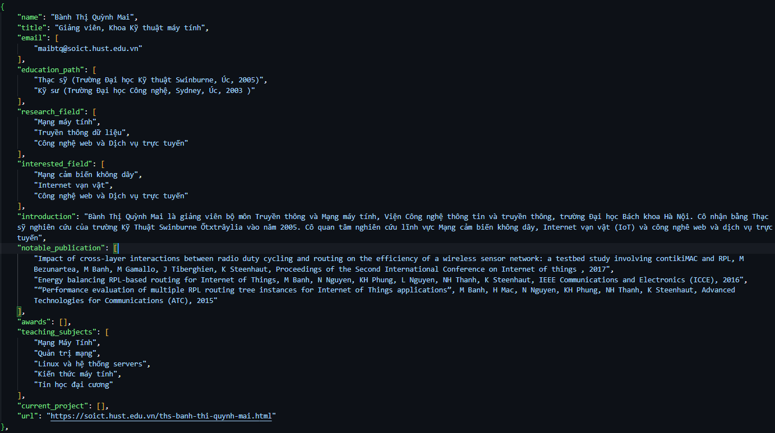
1.2.2. Lecturer data

Slide 13
1.3. Methods
3 main modules:
Router.
Retrieval Augmented Generation.
Text2SQL.
Large Language Model: Llama3.1-8B
Offers good trade-off between performance and latency.
Support multilingual.
LLM is hosted locally using Ollama.
Ollama is a lightweight framework for running LLM locally.

Slide 14
1.3.1. Router module
Prompt the LLM to decide which module should be used to answer the question.
Returns a JSON answer (using LLM JSON mode), with the desired route.

Slide 15
1.3.2. RAG module
Documents data are chunked using TikToken tokenizer with following parameters:
Chunk_size: 1024
Chunk_overlap: 200
Embedded model: BGE-M3
A multilingual, state-of-the-art embedding model for text.
The best for Vietnamese embedding in benchmark leaderboards.
Chunks are embedded, and ingested to Weaviate , a vector database.
Open source -> free, easy to debug.
Supports hybrid search.
Designed for natural language + numerical data.
Personal preference.

Slide 16
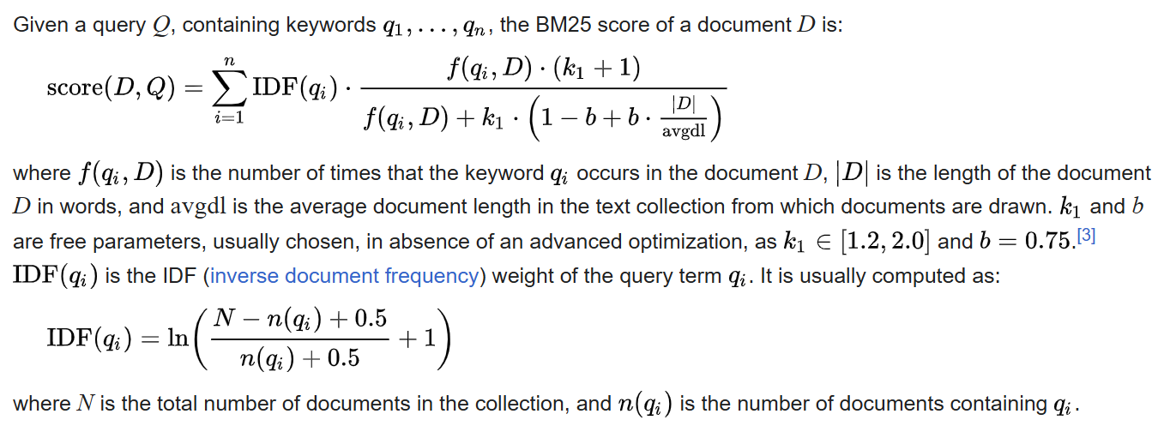
1.3.2. RAG module
When presented with a query, the system performs hybrid search:
Keyword search: searched using BM25 score
Semantic search: cosine similarity with chunks
The final score will be a weighted sum of the 2 scores

Slide 17
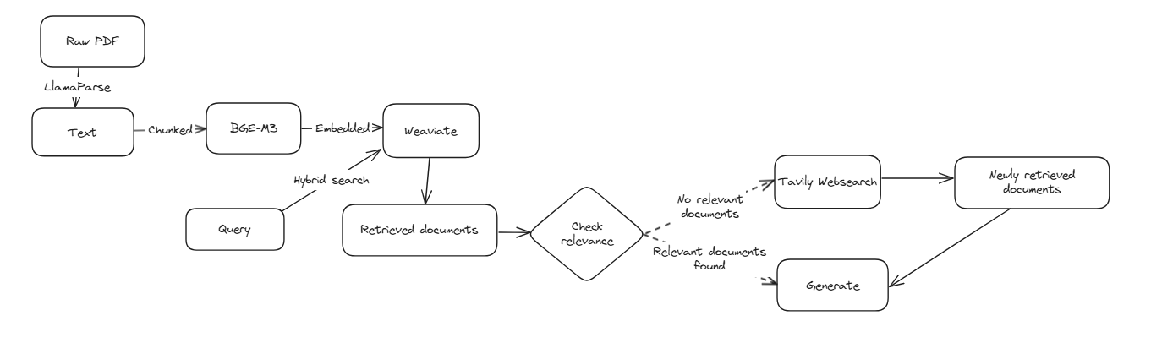
1.3.2. RAG module
Retriever gets top k (k=3) relevant documents.
System rechecks whether the 3 documents are truly relevant with LLM.
If no documents are relevant, go to Websearch (later explained) module for information.
If documents are relevant, generate response with LLM.

Slide 18
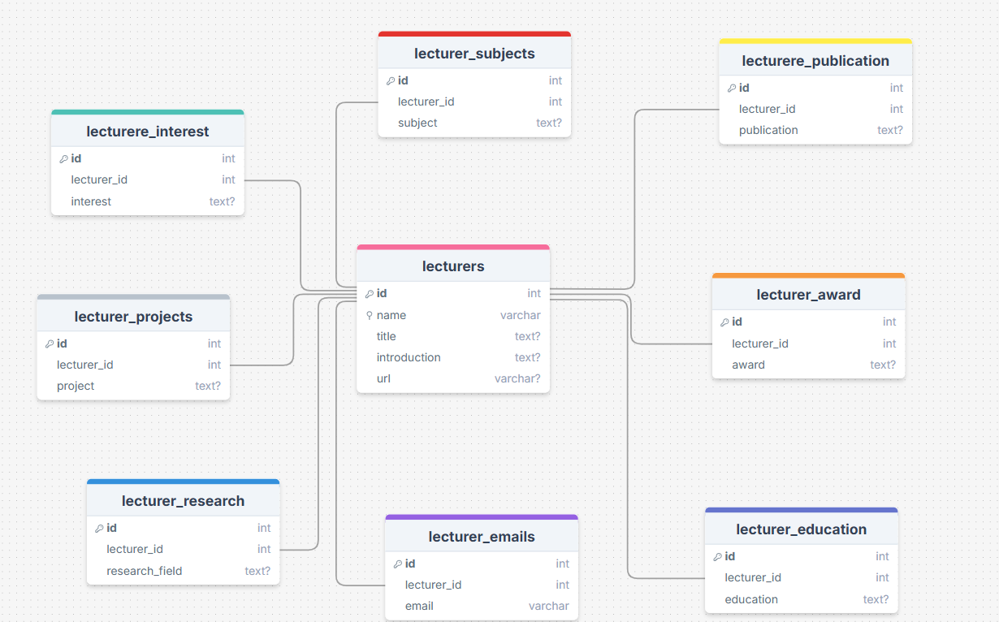
1.3.3. Text2SQL module
Lecturers data after being stored into JSON file need to be redesigned to fit a SQL Schema.
The schema:

Slide 19
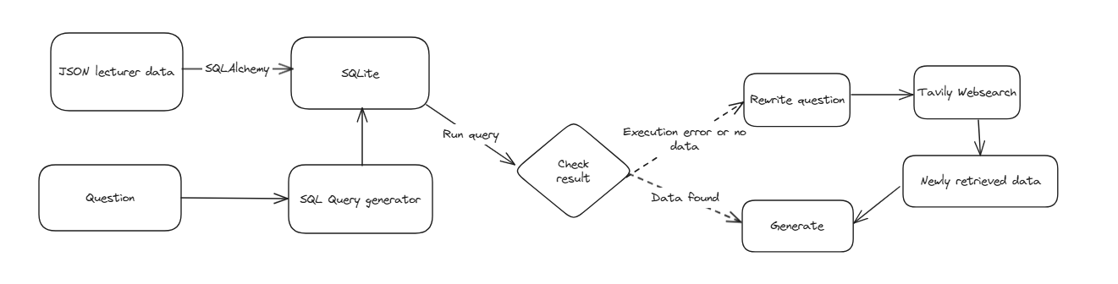
1.3.3. Text2SQL module
Data is ingested to SQLite database via SQLAlchemy.
Flow
Questions will be rewritten to SQL query via a LLM with prompts of schema description + few-shot example.
SQL query will be run to retrieve context.
If no result found, rewrite question and route to Web search module for information.
Else, generate response with retrieved results.

Slide 20
1.3.4. Web search module
Web search is used as a fallback when there is no relevant documents for RAG or no SQL result for Text2SQL.
Utilized Tavily Web Search:
A search engine optimized for LLMs, aimed at efficient, quick and persistent search results.
Real time information.
Easy to integrate

Slide 21
1.3.4. Web search module
How Tavily differs from other search engines?
Traditional search APIs sometimes are irrelevant to search goal and returns simple URLs or snippet of content (not always relevant).
Need to scrape the web for content, filter information,…
Tavily handles all in 1 API call.
aggregates up to 20 sites per a single API call
uses proprietary AI to score, filter and rank the top most relevant sources and content to your task, query or goal.
Can add custom fields such as context and limit response tokens to enable the optimal search experience for LLMs.
→ Versitile, customizable

Slide 22
1.4. Results and Evaluation
I evaluated the system with both human evaluation and metrical evaluation.
Evaluation is splitted into modules, each module having its own evaluation metrics.
All of the evaluation requires creation of test dataset by hand and by synthesizing, some metrics require an evaluator LLM (GPT-4o-mini in this case).
-> Have only finished the RAG evaluation due to resource limitation.

Slide 23
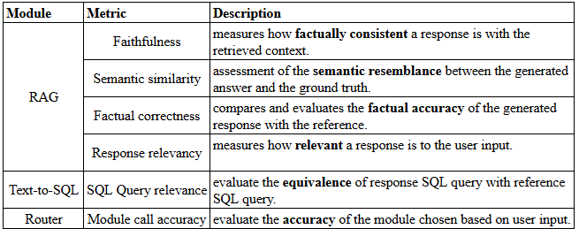
1.4. Evaluation
Evaluation metrics:
All evaluation are done via Ragas
Ragas is a library that provides tools to supercharge the evaluation of Large Language Model (LLM) applications.
Designed to help you evaluate your LLM applications with ease and confidence.

Slide 24

1.4.1. RAG evaluation: Faithfulness
Faithfulness:
measures how factually consistent a response is with the retrieved context.
Ranges from 0-1, higher is better
A response is considered faithful if all its claims can be supported by the retrieved context.
1. Identify all the claims in the response.
2. Check each claim to see if it can be inferred from the retrieved context.
3. Compute the faithfulness score using the formula:

Slide 25
1.4.1. RAG evaluation: Response Relevancy
Response relevancy:
measures how relevant a response is to the user input
Higher scores indicate better alignment with the user input, while lower scores are given if the response is incomplete or includes redundant information.
An answer is considered relevant if it directly and appropriately addresses the original question.
This metric focuses on how well the answer matches the intent of the question, without evaluating factual accuracy.
It penalizes answers that are incomplete or include unnecessary details.

Slide 26
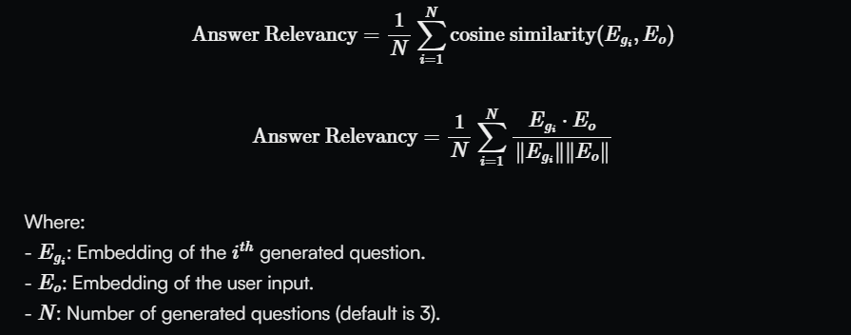
1.4.1. RAG evaluation: Response Relevancy
This metric is calculated using the user_input and the response as follows:
Generate a set of artificial questions (default is 3) based on the response. These questions are designed to reflect the content of the response.
Compute the cosine similarity between the embedding of the user input and the embedding of each generated question.
Take the average of these cosine similarity scores to get the Answer Relevancy:

Slide 27
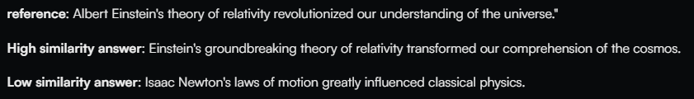
1.4.1. RAG evaluation: Semantic Similarity
Semantic Similarity
Measures semantic resemblance between the generated answer and the ground truth
Ranges from 0 – 1, higher is better.
Evaluator embedding model: text-embedding-3-large.
How it is calculated:
Vectorize the ground truth answer using the specified embedding model.
Vectorize the generated answer using the same embedding model.
Compute the cosine similarity between the two vectors.

Slide 28
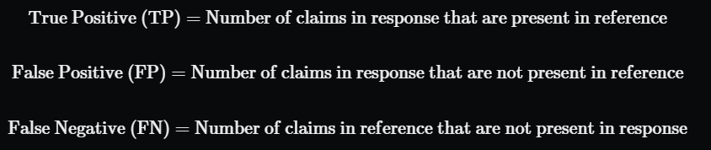
1.4.1. RAG evaluation: Factual Correctness
Factual Correctness
compares and evaluates the factual accuracy of the generated response with the reference.
Ranges from 0 – 1, higher is better.
How it is calculated:
uses the LLM to first break down the response and reference into claims
uses natural language inference to determine the factual overlap between the response and the reference.
Factual overlap is quantified using precision, recall, and F1 score. Default is F1.

Slide 29
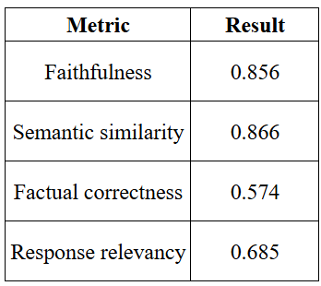
1.4.1. RAG evaluation: Result
Results
System tends to output correct information and are highly similar to the questions. However, information might be missing or redundant compared to the context.

Slide 30
1.4.2. Text2SQL evaluation (Plan)
SQL Query Equivalence:
A metric that can be used to evaluate the equivalence of response query with reference query.
Also needs database schema.
A binary metric, 0 if not similar, 1 if similar semantically.
Have not tested
Test dataset creation time is time consuming.
Text2SQL still needs improving.

Slide 31
1.4.3. Router evaluation (Plan)
Module call accuracy
Evaluate the accuracy of the module chosen based on user input.
A binary metric, 0 being inaccurate and 1 being accurate.
4 labels: irrelevant, RAG, Text2SQL, Websearch.
To be done later.

Slide 32
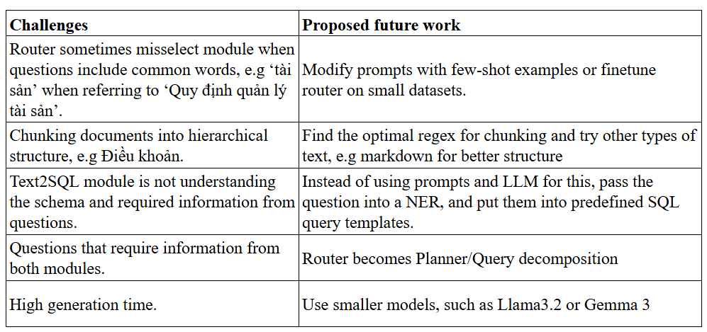
1.5. Challenges and Future work

Slide 33
2. Visual Question Answering

Slide 34
2.1. Introduction
Motivation
Current Vision Language models are either too large or underperform, or close-sourced.
Sacrifice unimodal performance for multimodal.
Goal
Create a Visual Question answering model that is lightweight, yet still achieving on par performance with big models.

Slide 35
2.1.1. Proposed method
Finetune the PaliGemma model
A visual language model built to cover standard tasks such as image classification, captioning,visual question-answering and dialogue.
Based on Pali-3 architecture but utilizes open-source models to compose the architecture
3B parameters
Still too heavy for our resource since image-text tasks require significantly more memory than text-only tasks.
Quantized Low Rank Adaptation
Build and train a baseline model for comparison.

Slide 36
2.2. Data preparation
Dataset: VizWiz-VQA dataset
Answer Visual Question for People Who Are Blind
Blind people take image of something + a question, gather answer from 10 people/question
Dataset contains:
20,523 training image/question pairs.
205,230 training answer/answer confidence pairs.
4,319 validation image/question pairs.
43,190 validation answer/answer confidence pairs.
8,000 test image/question pairs.

Slide 37
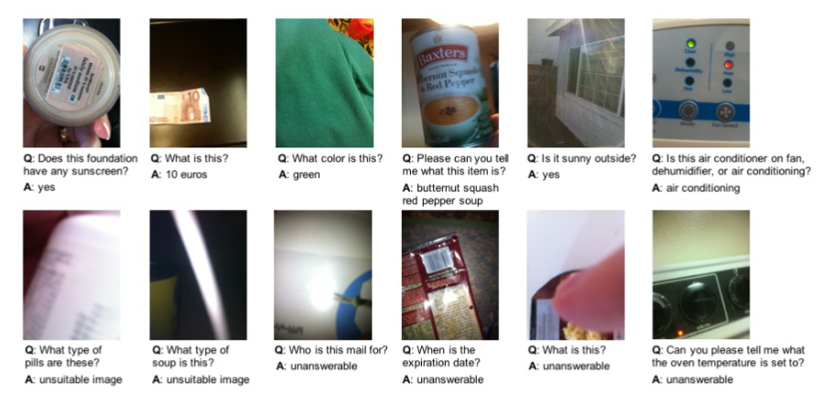
2.2. Data preparation

Slide 38
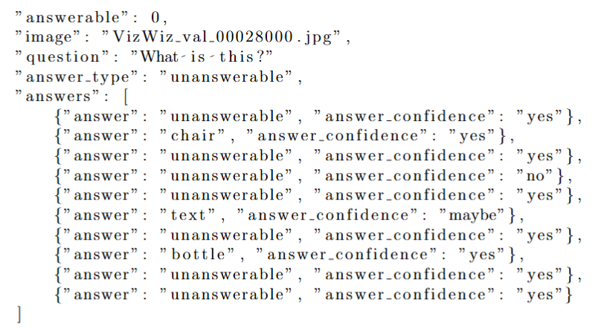
2.2. Data preparation
Annotation: Data are annotated in a JSON file with the following fields
Answerable: whether the question is answerable
Image: image path
Question
Answer type: answerable, unanswerable, unsuitable
Answers: list of 10 answers recorded -> most common is selected

Slide 39
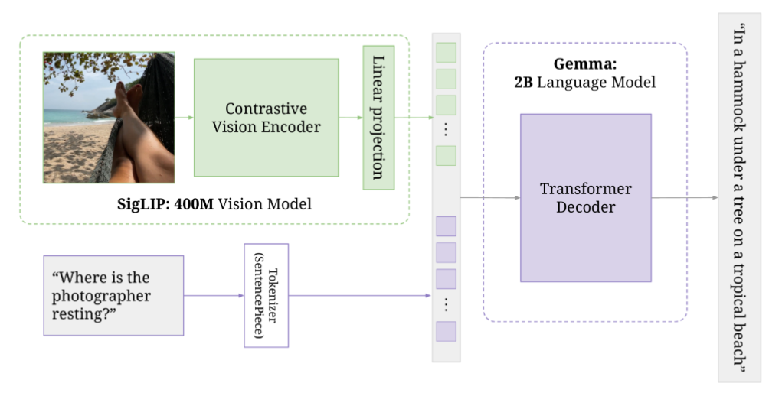
2.3.1. Methods: PaliGemma
PaliGemma architecture
Consist of 3 components
Image encoder: SigLIP checkpoint
Decoder-only LM: Gemma 2B, enough to surpass larger models like in Pali (mT5-XXL 13B)
Linear projection layer

Slide 40
2.3.2. Baseline model
We still follow the PaliGemma architecture, but use baseline models for each modality:
Vision encoder: A ResNet18 model.
NLTK for tokenize and LSTM for embedding (replacing the Gemma tokenizer).
Text decoder: A base Transformer decoder
Total: ~91 million parameters.
Vocabulary is built from the training dataset.
Training parameters:
Epoch: 10.
Learning rate: 0.001.
Loss function: Cross Entropy.
AdamW optimizer.

Slide 41
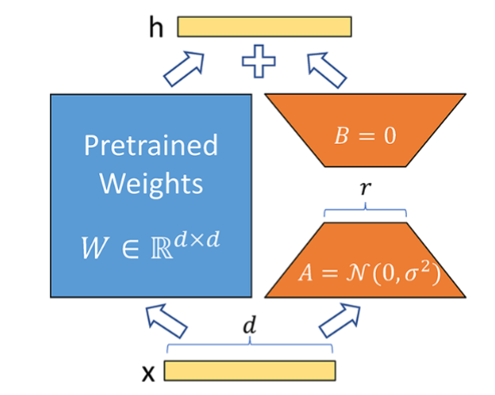

2.3.3. LoRA
Low Rank Adaptation
A technique used to enhance the efficiency of training large language models.
It focuses on optimizing a smaller number of parameters by decomposing the original parameter space into low-rank matrices.

Slide 42
2.3.4. QLoRA
Quantized Low Rank Adapatation
An efficient finetuning approach that reduces memory usage enough to finetune a 65B parameter model on a single 48GB GPU while preserving full 16-bit finetuning task performance.
QLORA backpropagatesgradients through a frozen, 4-bit quantized pretrained language model into Low Rank Adapters.
Key innovations to save memory
4-bit NormalFloat: a new data type that is information theoretically optimal for normally distributed weights.
Double Quantization: quantize the quantize constants
Paged Optimizers: use Nvidia unified memory to handle GPU mem limit. If GPU runs out, paged between CPU and GPU without error.
Finetune parameters:
Epoch: 1
Learning rate: 1e-5
LoRA rank: 8
….

Slide 43
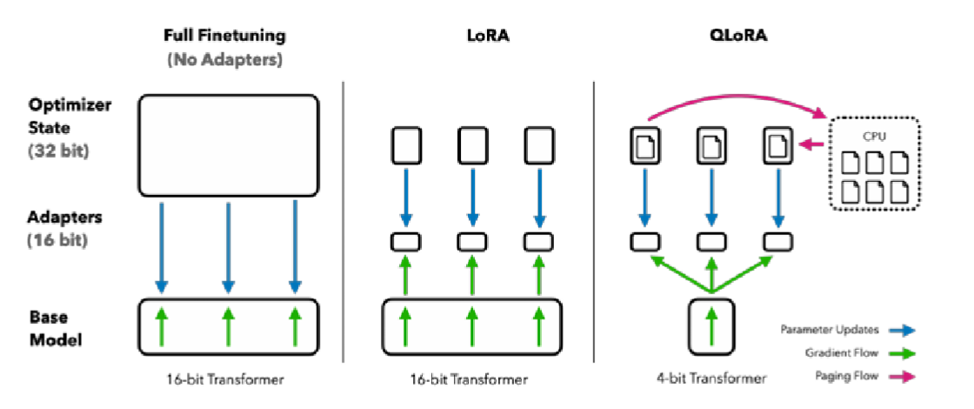
2.3. Methods

Slide 44

2.4. Result
For the evaluation metric, VizWiz metric is used:
Accuracy:
Baseline: 0.1139.
Our PaliGemma: 0.76, exceeding the result published on the PaliGemma paper.

Slide 45
THANK YOU !

